Slide 1
Adjacency Matrix Representation
Example: Undirected Graph G (V, E)
 | v | u | w
v | 0 | 1 | 1
u | 1 | 0 | 1
w | 1 | 1 | 0
u
v
w
Notes:
Note that the matrix is always symmetric for an undirected graph.

Slide 2
Adjacency List Representation
Each node (vertex) has a list of which nodes (vertex) it is adjacent.
u
node | Adjacency List
u | v , w
v | w, u
w | u , v
v
w

Slide 3
Adjacency Matrix Representation
Example: directed Graph G (V, E)
u
 | v | u | w
v | 0 | 1 | 1
u | 0 | 0 | 1
w | 1 | 0 | 0
v
w

Slide 4
Adjacency List Representation
u
node | Adjacency List
u | w
v | u, w
w | v
v
w
Note that here (v,w) and (w,v) are considered separate edges, while in an undirected graph they would be considered two ways to write the same edge and wouldn’t both be listed.

Slide 5
Counting Walks in Adjacency Matrices
How many walks of length 2 exists in this Adjacency matrix?
 | A | B | C
A | 0 | 1 | 1
B | 1 | 0 | 0
C | 1 | 0 | 0
Notes:
It’s difficult to be sure you’ve found all walks of a length greater than one by hand, so we multiply matrices instead.

Slide 6
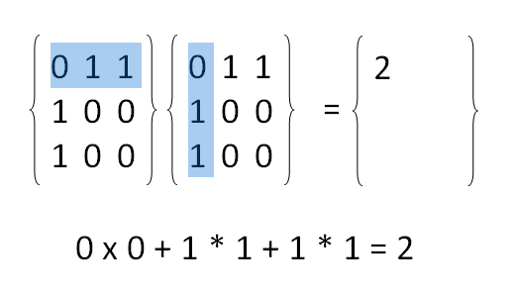
Matrix Multiplication

Slide 7
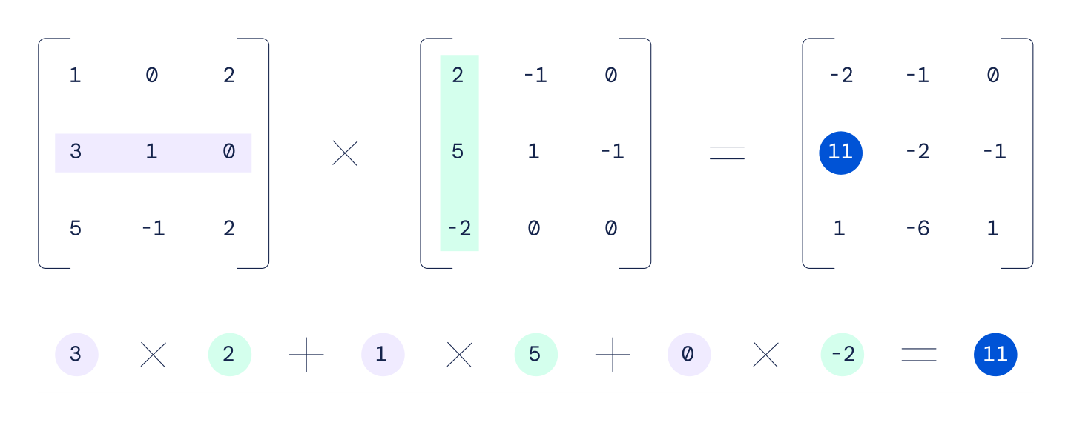
Matrix Multiplication

